Slide 1
Digital Portfolios in a Web 2.0 World
Jonan Donaldson
Notes:
Start

Slide 2
Who Am I?
Notes:
This is the front page of a digital portfolio I designed in HTML using Dreamweaver years ago for my Master’s Degree. That was my first exposure to digital portfolios.

Slide 3
Oregon State University
Instructional Designer
Ecampus
Notes:
Oregon State University: I’m an Instructional Designer for Oregon State University. I help faculty build online courses.

Slide 4
Western Oregon University
Instructor
Master of Science in Education:
Information Technology
Notes:
Western Oregon University: I teach in the Master of Science in Education: Information Technology program at Western Oregon University where we use a digital portfolio model. I teach courses built on the digital portfolio structure. I also teach a course on designing digital portfolios.

Slide 5
Student Portfolios
Notes:
Here are a few screenshots of my students’ portfolios.

Slide 6
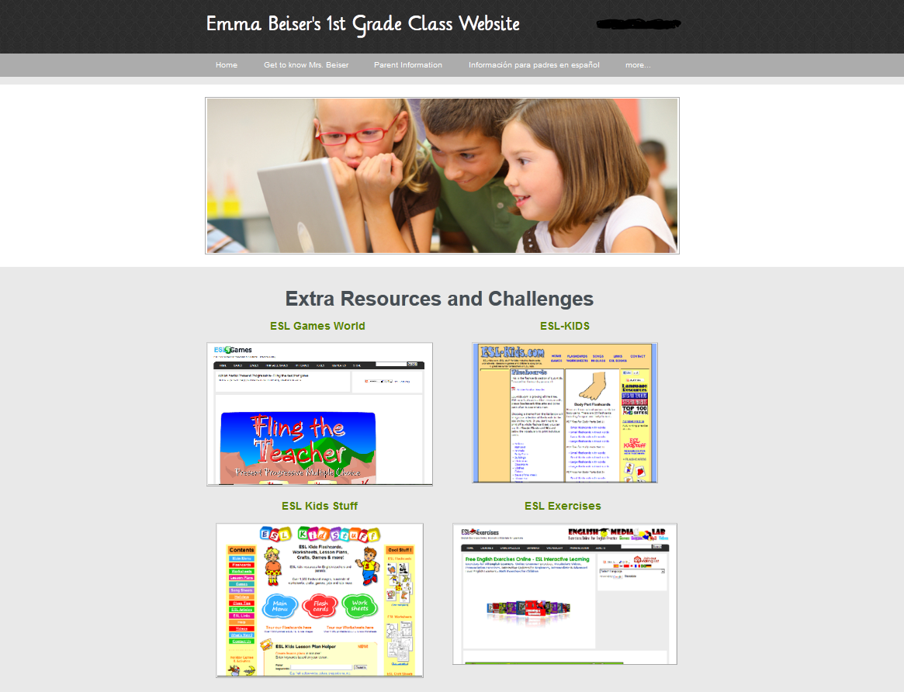
Student Portfolio 1
Used with the permission of the author.
Notes:
Student Portfolio 1

Slide 7
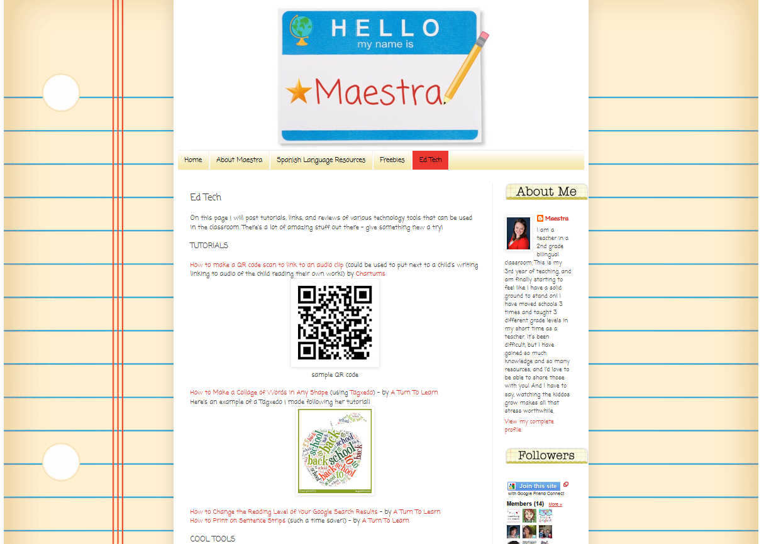
Student Portfolio 2
Used with the permission of the author.
Notes:
Student Portfolio 2

Slide 8
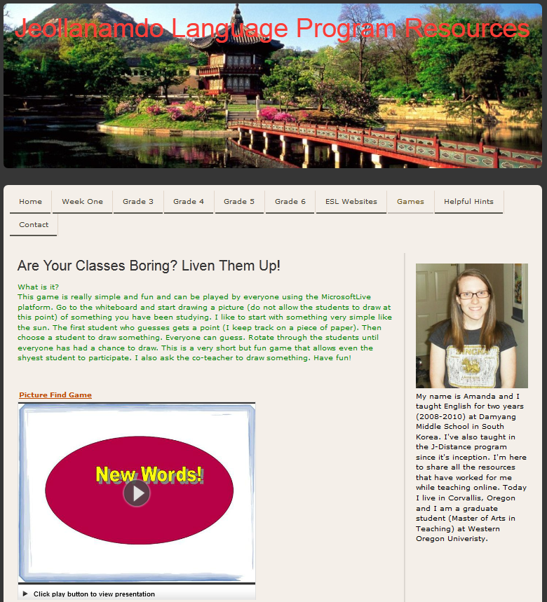
Student Portfolio 3
Used with the permission of the author.
Notes:
Student Portfolio 3

Slide 9
What is a Digital Portfolio?
Notes:
What is a Digital Portfolio?

Slide 10
Digital Portfolio Definition Part 1:
A digital portfolio is a collection of artifacts of learning in digital format…
Notes:
Digital Portfolio Definition Part 1:

Slide 11
Digital Portfolio Definition Part 2:
organized and presented in a meaningful way…
Notes:
Digital Portfolio Definition Part 2:

Slide 12
Digital Portfolio Definition Part 3:
The artifacts individually, and the portfolio in whole, demonstrate mastery of learning…
Notes:
Digital Portfolio Definition Part 3:

Slide 13
Digital Portfolio Definition Part 3:
Digital portfolios require meta-cognition and reflection in the process of building, organizing, and presenting the digital portfolio.
Notes:
Digital Portfolio Definition Part 3:

Slide 14
Educational Theory
Project-Based Learning
Collaborative Learning
Inquiry-Based Learning
Notes:
Educational theorists and educators have been discussing the educational benefits of portfolios for many years. Since 1991 Dr. Helen Barrett started promoting the use of digital portfolios.

Slide 15
Project-Based Learning
Notes:
Project-Based Learning: Digital portfolios are an ideal means of structuring project-based learning (Gulbahur & Tinmaz, 2006).

Slide 16
Collaborative Learning
Notes:
Collaborative Learning: The actual structure of digital portfolios encourage collaborative learning (Chelliah & Clarke, 2011).

Slide 17
Inquiry-Based Learning
Notes:
Inquiry-Based Learning: Inquiry-based learning, especially in the sciences, requires a structure upon which to build schema. Digital portfolios allow learners to create their own structures, therefore putting the inquiry directly in the hands of the learners (Lee, 2011).

Slide 18
Digital Literacies
Identity
Privacy
Read/Write
Information Management
Social Media
Notes:
Digital Literacies: Digital portfolios, if built using Web 2.0 tools, will help learners develop their digital literacies.

Slide 19
Why Digital Literacy Matters
The role of the teacher is to help students “produce as well as consume digital culture, and they need to be taught how to use digital tools for communication and collaboration purposes, and to contribute in ethical ways – through a greater knowledge of themselves and a shared knowledge of others – to the collective intelligence of the knowledge space.” (Poore, 2011)
Notes:
The role of the teacher is to help students “produce as well as consume digital culture, and they need to be taught how to use digital tools for communication and collaboration purposes, and to contribute in ethical ways – through a greater knowledge of themselves and a shared knowledge of others – to the collective intelligence of the knowledge space.” (Poore, 2011)

Slide 20
Identity and Privacy
This is me.
Notes:
Identity and Privacy: Students need to learn not only how to protect their privacy online, but also how to manage their identities.

Slide 21
“Write” in the Read/Write Web
Notes:
“Write” in the Read/Write Web: The world has changed. In the past, most were consumers, and few were producers. Now everyone can be a producer. Success often depends on one’s ability to “Write”—to produce digital content.

Slide 22
Information Management Skills
Notes:
Information Management Skills: Students must be taught the skills of information management, and these skills should be reinforced every day. These skills include finding, organizing, evaluating, synthesizing, and transforming information.

Slide 23
Social Aspects of the Internet
Notes:
Social Aspects of the Internet: Social media isn’t just about Facebook. Social aspects of the internet range from comments on news articles to building blogs, wikis, and websites. It also includes professional social media such as LinkedIn.

Slide 24
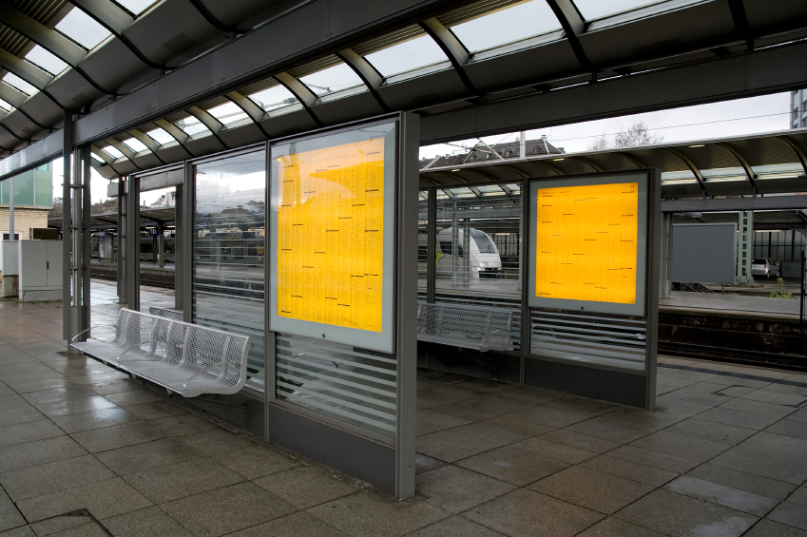
Platforms
Portfolio Software
Adobe Acrobat
Learning Management System
Website-Based Portfolios
Notes:
Platforms: There are many platforms for digital portfolios, including software, Acrobat, LMS, and Website-Based Portfolios.

Slide 25
ePortfolio Software
Campus Labs
Carbonmade
Desire2Learn ePortfolio
Digication
eduPortfolio
eFolioWorld
eLumen
FolioSpaces
FolioTek
Interfolio
Learning Objects
Mahara
MooFolio
NuVentive
Passportfolio
PebblePad
Rcampus
Scioware ePortfolio
Studywiz ePortfolio
…
Notes:
Portfolio Software: It seems like a new piece of portfolio software pops up every month or two. This is just a small sampling of the software I have investigated.

Slide 26
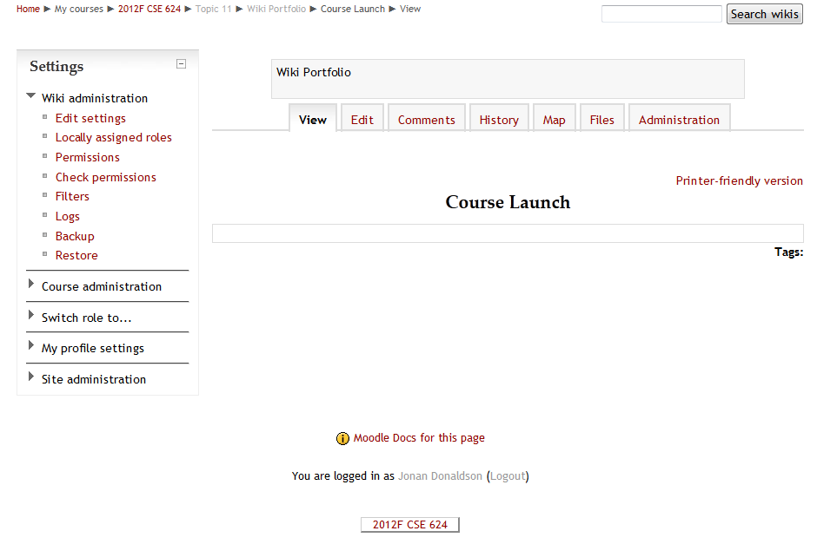
Portfolios Within an LMS
Notes:
Moodle Wiki Portfolio: You can also build a portfolio within an LMS. I have used the Wiki tool in Moodle for digital portfolios.

Slide 27
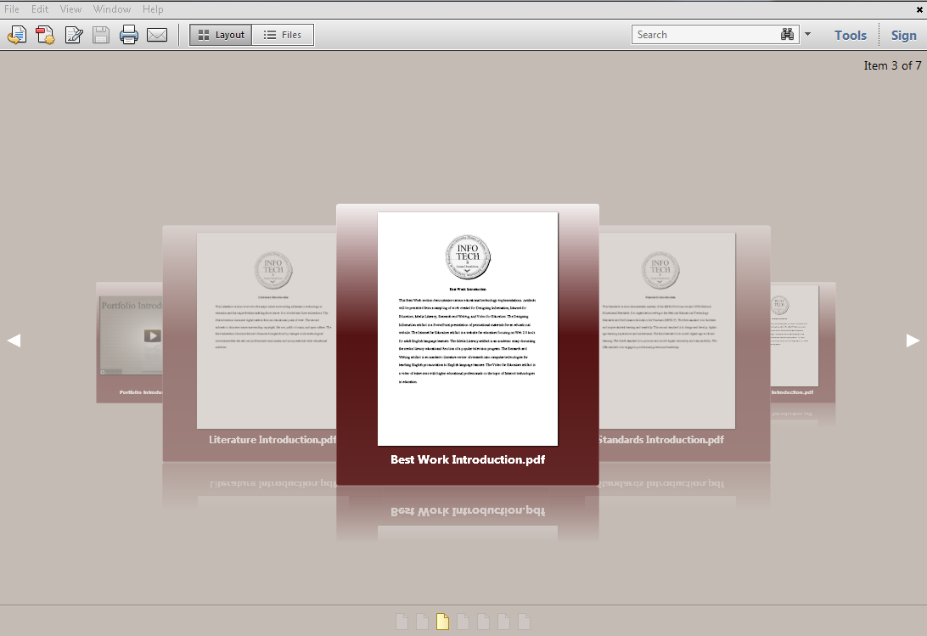
Acrobat Portfolios
Notes:
Acrobat Portfolio is probably the most beautiful solution for throwing together a bunch of files and calling it a digital portfolio.

Slide 28
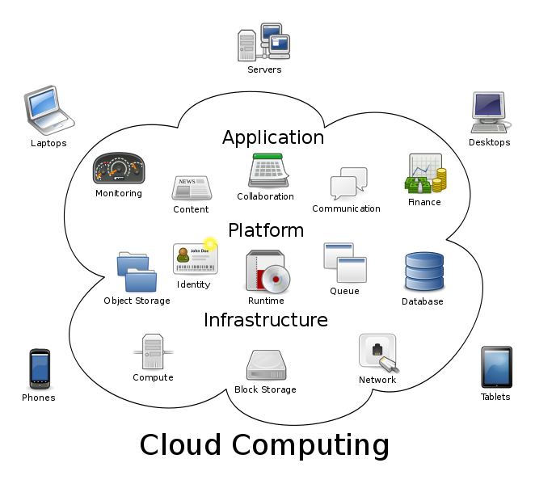
The Cloud
By 百楽兎 [CC-BY-SA-3.0 (http://creativecommons.org/licenses/by-sa/3.0) or GPL (http://www.gnu.org/licenses/gpl.html)], via Wikimedia Commons
By Sam Johnston [CC-BY-SA-3.0 (http://creativecommons.org/licenses/by-sa/3.0)], via Wikimedia Commons
Notes:
The Cloud: The problem with these solutions is that they are based on an outdated model of technology. Files are fast fading into history. We need to prepare our students for the future they will be living in, not the world of floppy disks. This is the world of the cloud.

Slide 29
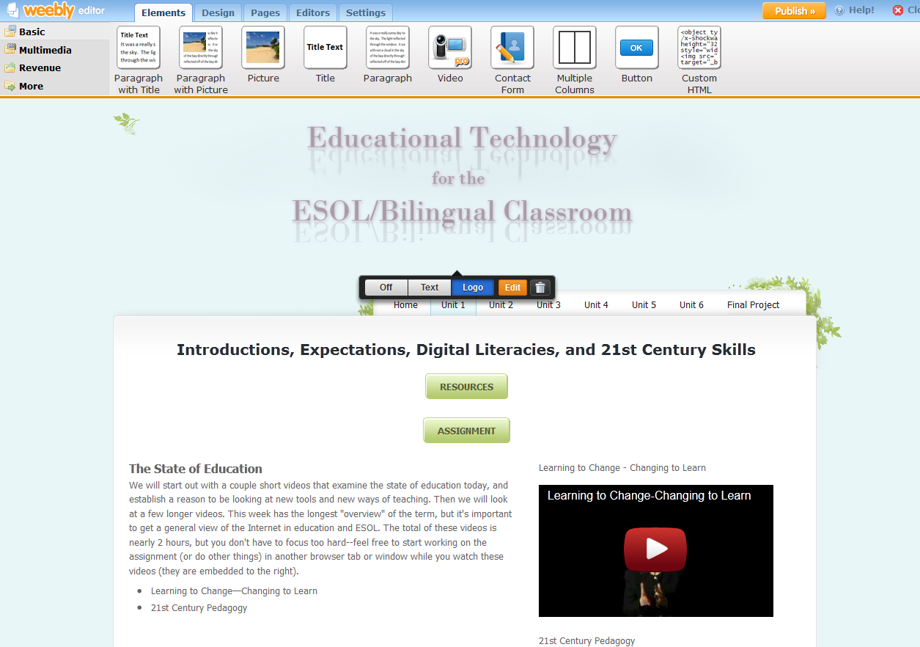
Weebly
Notes:
Weebly is the tool my students most often select for building their digital portfolios.

Slide 30
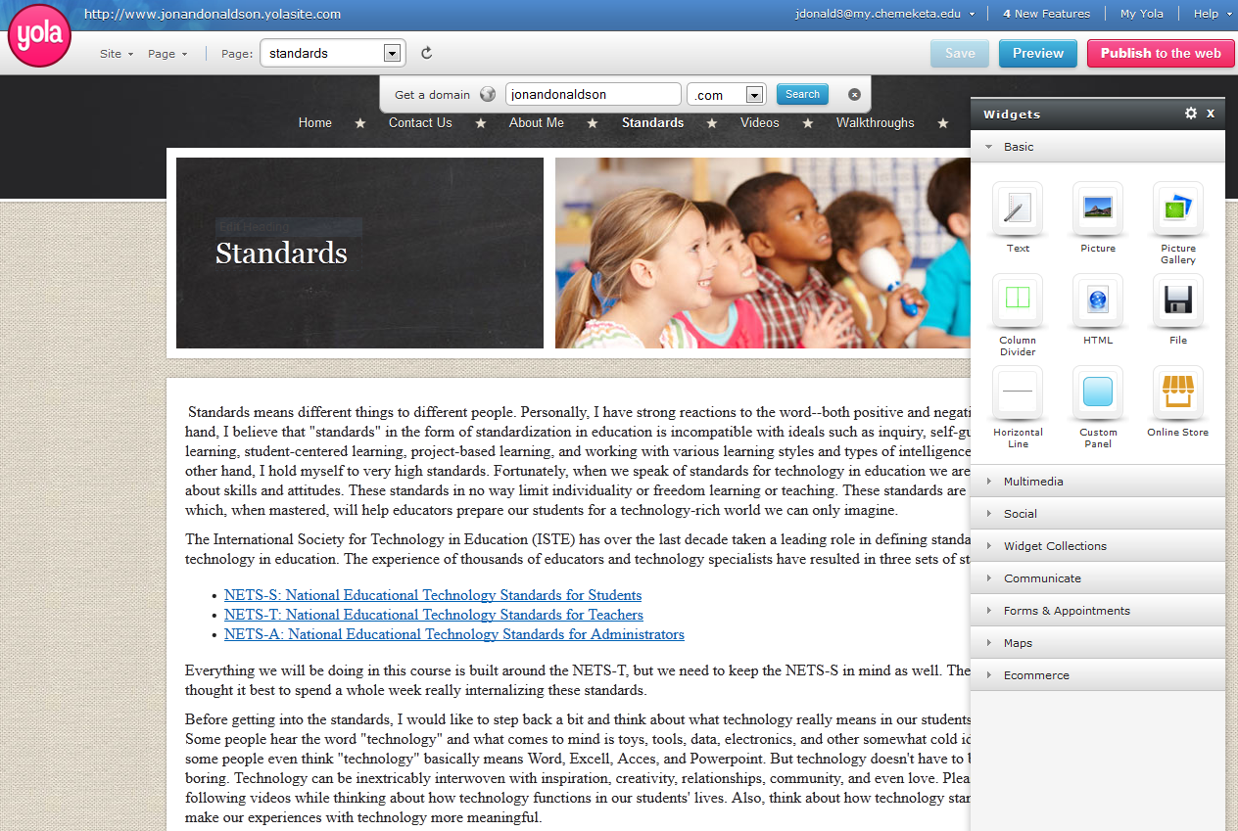
Yola
Notes:
Yola is the second most popular choice among my students.

Slide 31
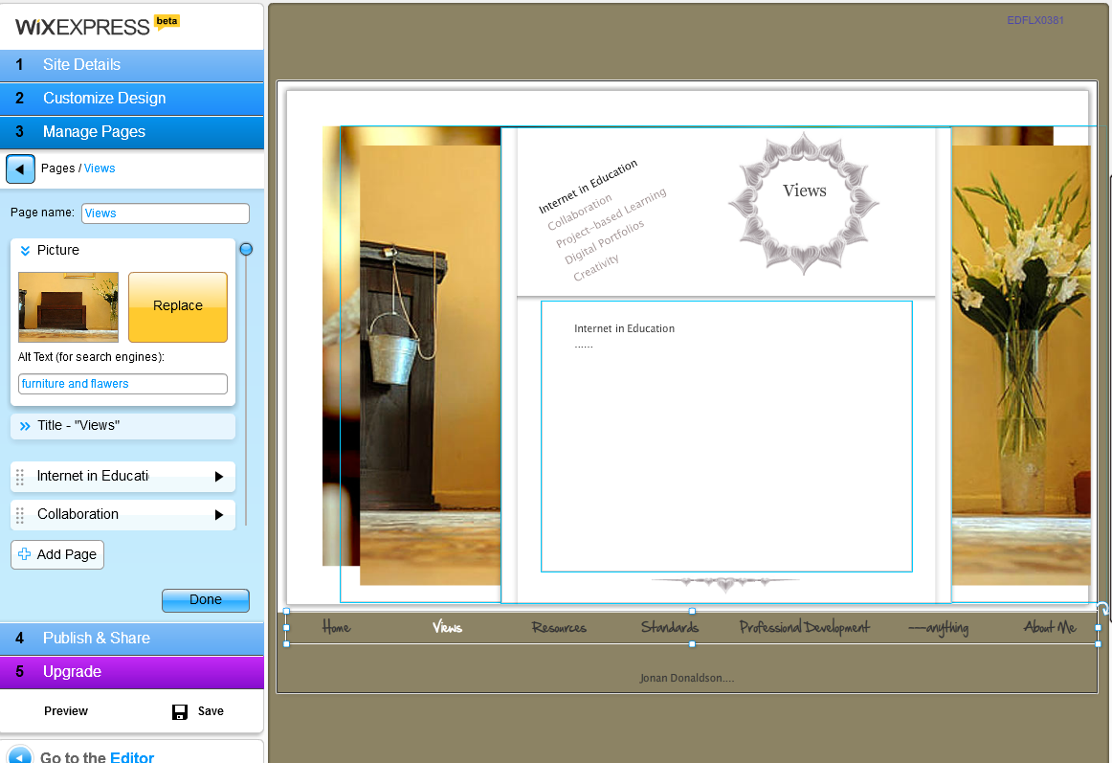
Wix
Notes:
Wix: When students get frustrated with the limitations of Weebly and Yola, especially in terms of design, they use Wix. It is a bit harder to use, but produces more beautiful results.

Slide 32
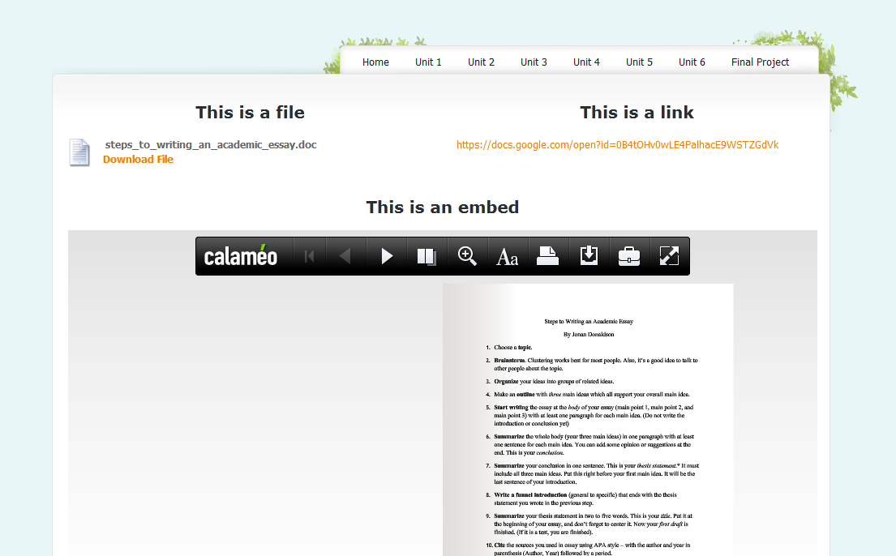
Embed
Notes:
Weebly, Yola and Wix are free website creation and hosting services. Why use these?
Embed: The greatest benefit of the web-based digital portfolio is the ability to embed artifacts.

Slide 33
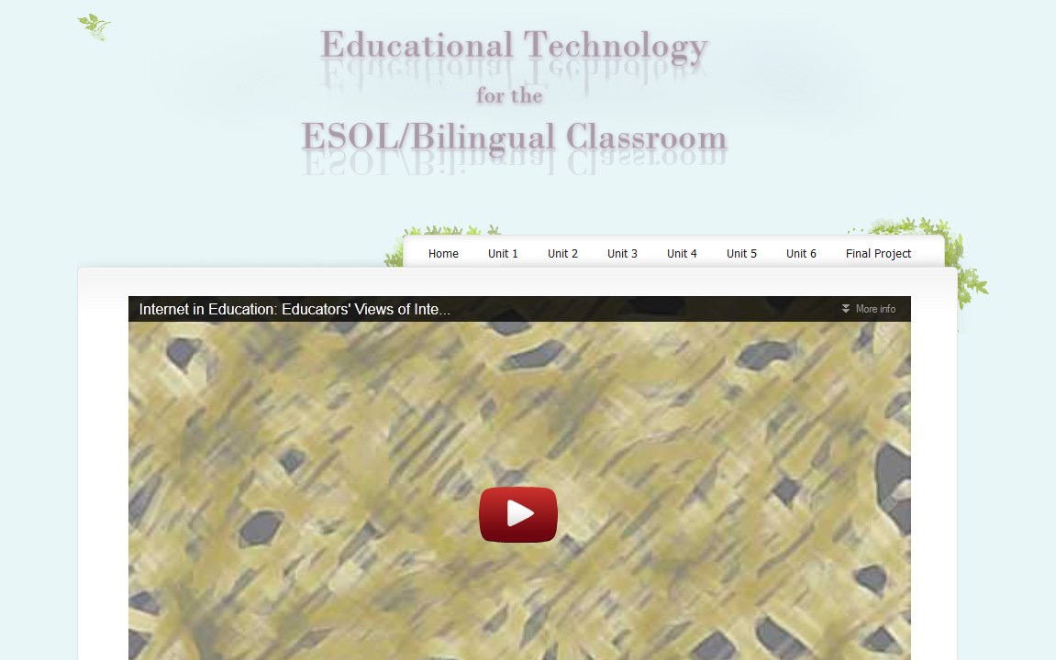
Embed: YouTube
Notes:
Embed: Rather than linking to a YouTube video, isn’t it more powerful to have that video right there on a page in your portfolio?

Slide 34
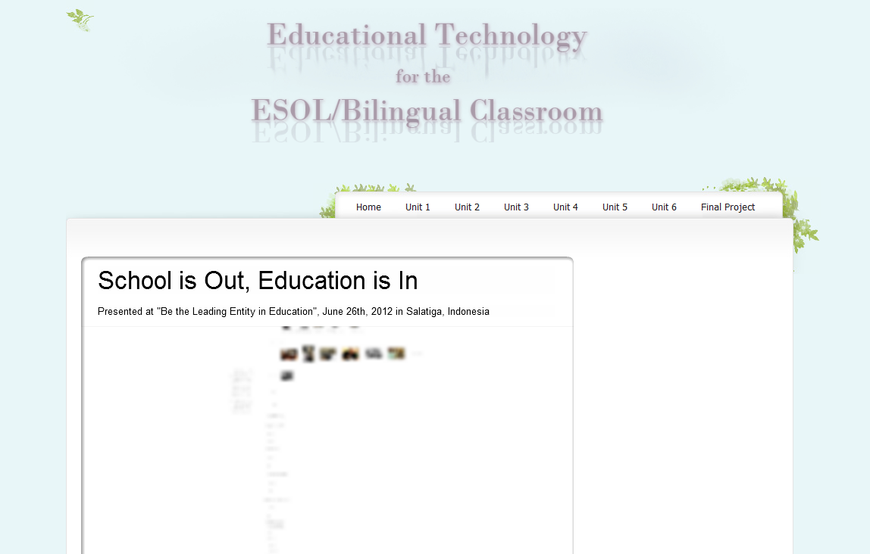
Embed: Prezi
Notes:
Embed: Rather than giving their teacher a folder which contains PowerPoint files, wouldn’t it be better to have a portfolio full of pages including online presentations such as Prezi?

Slide 35
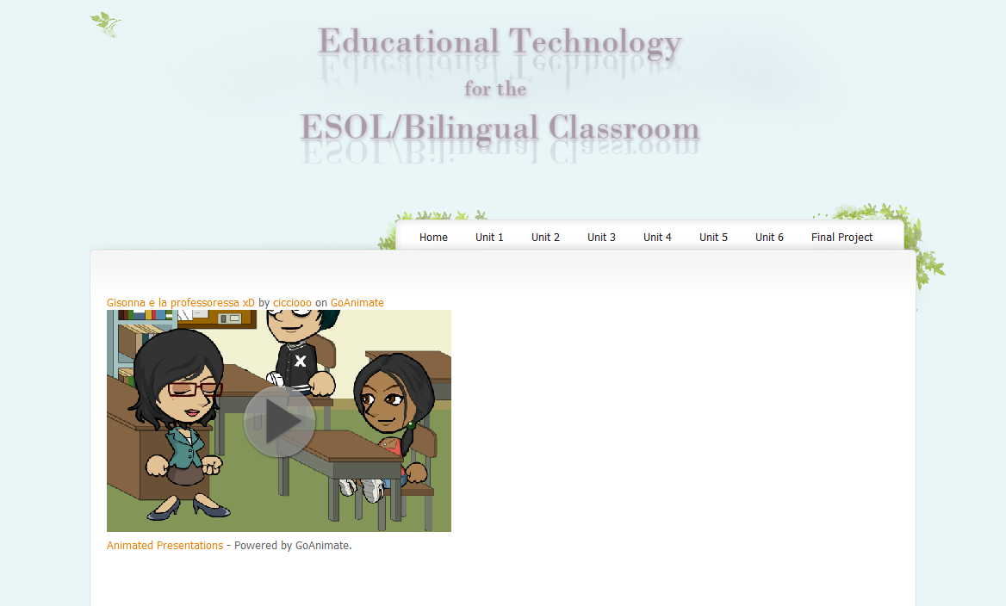
Embed: Go! Animate
Notes:
Embed: Wouldn’t some students be more motivated if they could fill their portfolios with artifacts such as animations?

Slide 36
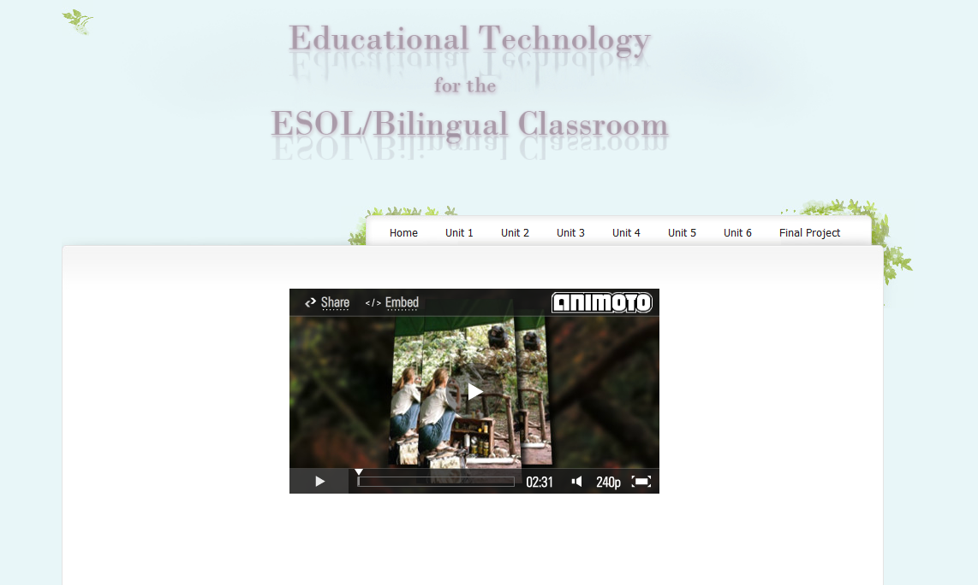
Embed: Animoto
Notes:
Embed: Or they could have a slideshow with music using Animoto.

Slide 37
Structure
Notes:
Structure: Digital portfolios built in website format can be easily structured to suit the specific needs of the portfolio using pages within the website.

Slide 38
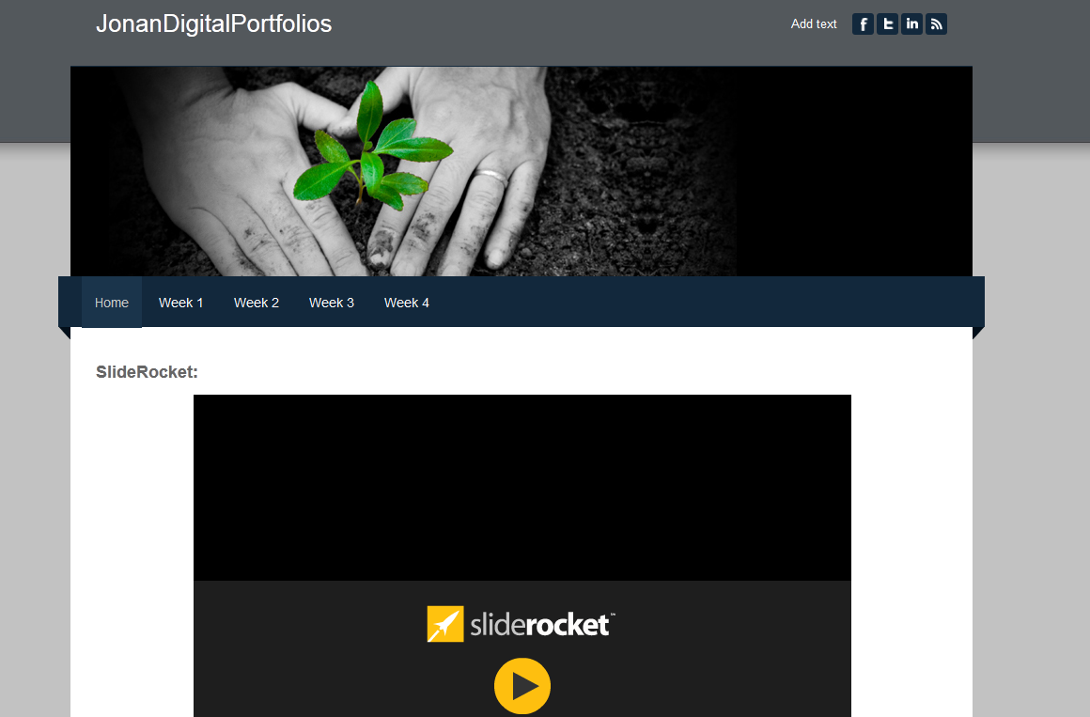
Weekly Structure
Notes:
Weekly Structure

Slide 39
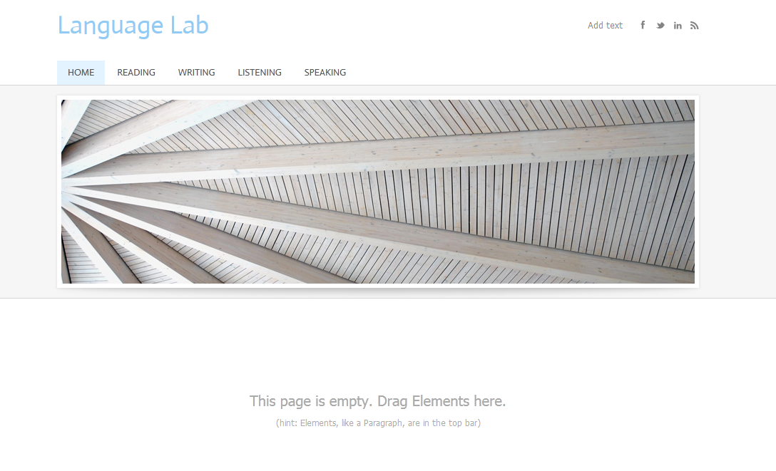
Thematic Structure
Notes:
Thematic Structure

Slide 40
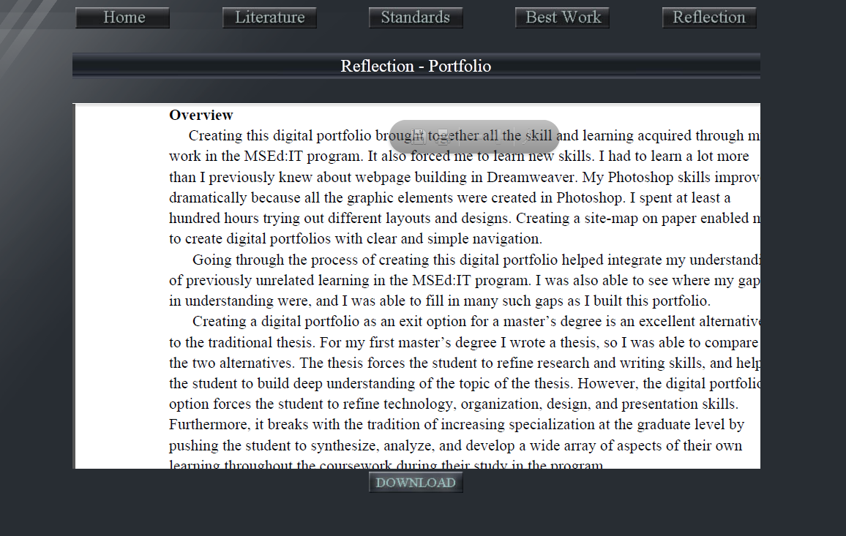
Reflection
Notes:
Structure: One of the most powerful aspects of a published website-based portfolio is that reflection can be part of the resulting product, not only part of the process.

Slide 41
Web 2.0 Tools
Notes:
Web 2.0 Tools: Artifacts created using web 2.0 tools can easily be embedded within a digital portfolio.

Slide 42
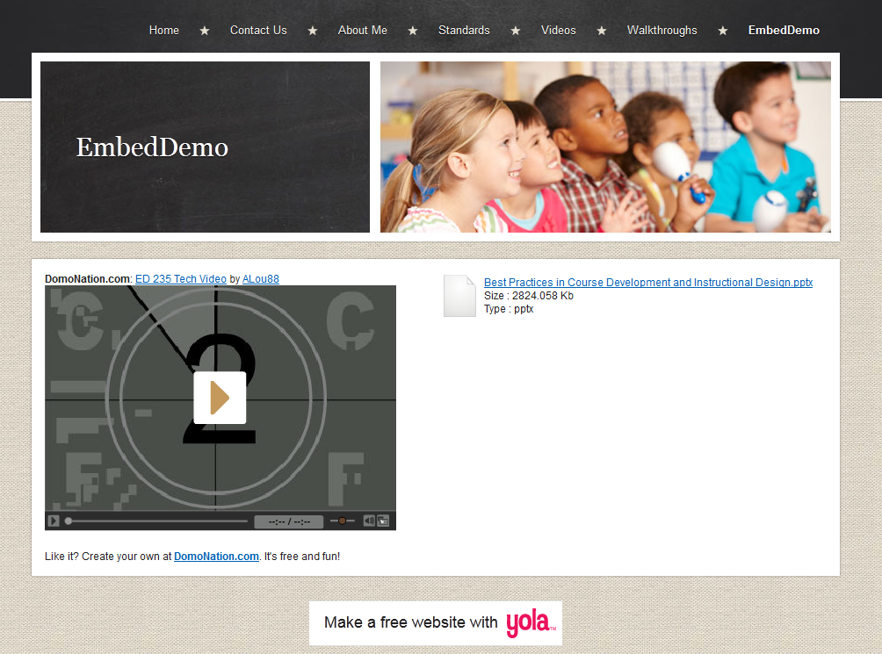
Embed vs. File
Notes:
Embed vs. File: Embedded artifacts are better than files or links because they are presented immediately within the page. Therefore, readers do not have to leave the current page to download a file or visit a link.

Slide 43
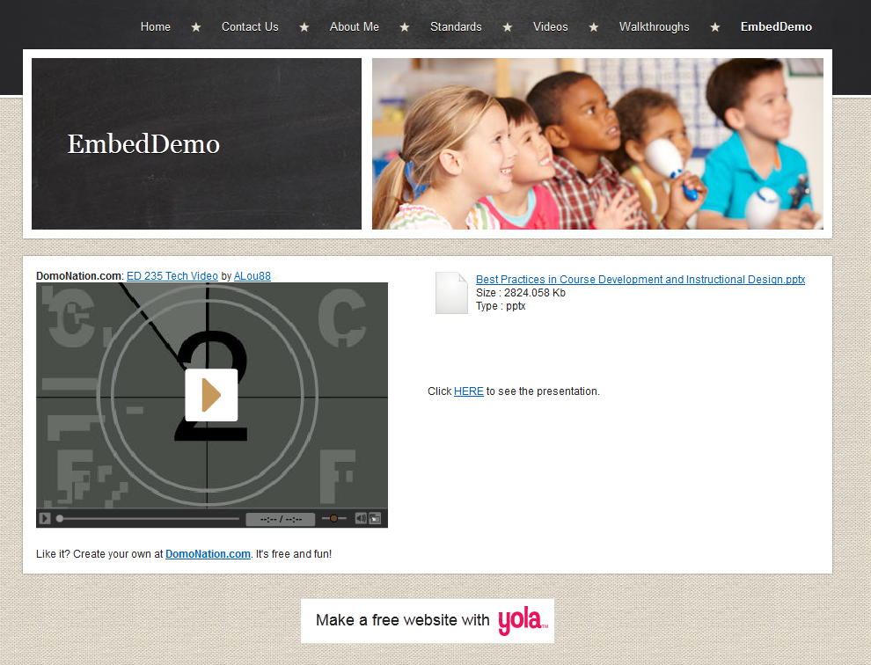
Embed vs. Link
Notes:
Embed vs. Link

Slide 44
A Rule from Web Design…
Rule: “If it can be embedded, it should be embedded.”
Notes:
If you were reading a book, and within the text of one of the pages it suggested that you visit a certain website. Would you do it? And if you did, would you immediately return to the book after visiting the website? We don’t want our readers to get distracted, we don’t want them to leave our page (will they come back?), and we don’t want to make them click any more than is needed.

Slide 45
Peer Feedback
Notes:
Assessment: Peer Feedback--Peer assessment and peer feedback concerning digital portfolios can easily be done using the forum discussion feature of any learning management system. For example, each week students can build and embed new artifacts, after which they publish a link in the forum discussion . I usually have my students respond in depth to at least five classmates’ work each week. Screenshot: Moodle Forum Instructions.

Slide 46
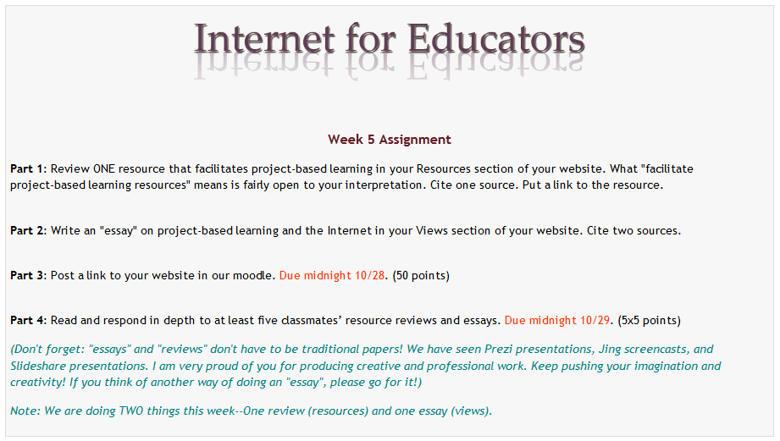
Moodle Forum Instructions
Notes:
Moodle Forum Instructions: I ask my students to give each-other feedback every week on the new artifacts they have created.

Slide 47
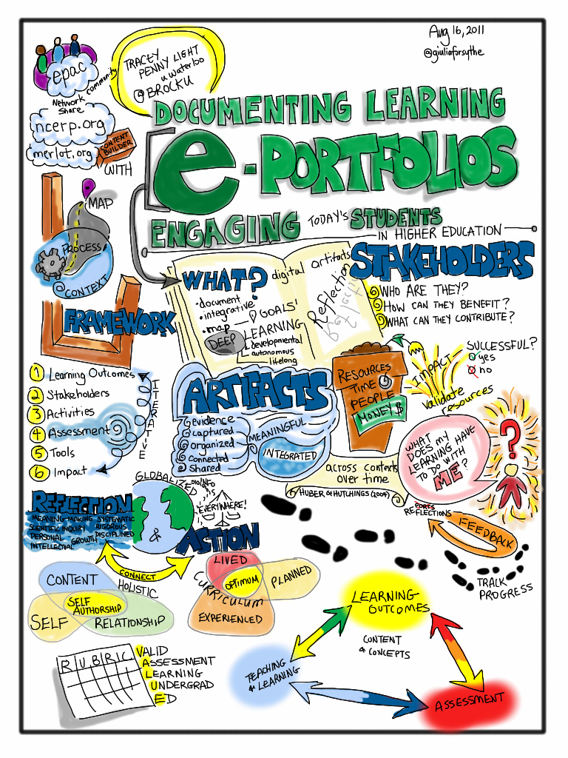
Rubrics
Creative Commons License CC BY-NC-SA 2.0, 2011 – Giulia Forsyth, Some rights reserved
Notes:
Rubrics

Slide 48
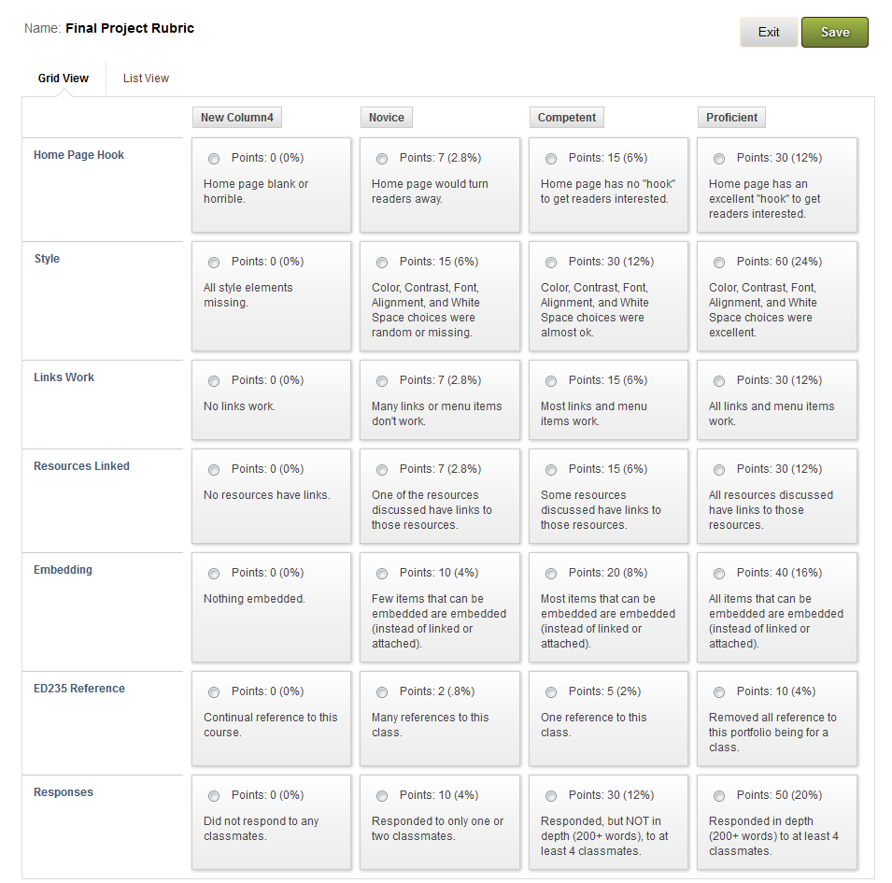
Rubrics
Notes:
Screenshot of Blackboard Rubrics: I use rubrics (in this case Blackboard) to assess portfolio work. I also create empty rubric shells in Google Docs and have students work as a class to create the rubrics by which they will be graded. Often I have them grade themselves or each-other.

Slide 49
Bringing it all Together
Knowledge
Skill
Collaborate
Structure
Publish
Create
Reflect
Notes:
Bringing it all Together: Although this graphic indicates a cycle, it also indicates an interplay between Knowledge, Skill, Collaboration, Creation, Structuring, Publishing, and Reflecting…

Slide 50
Takeaway 1:
The tools and platforms through which digital portfolios can be built have matured.
Notes:
TAKEAWAY 1: The tools and platforms through which digital portfolios can be built have matured.

Slide 51
Takeaway 2:
It is now possible to build digital portfolios using popular web 2.0 tools - technologies our students are already using in their daily life.
Notes:
TAKEAWAY 2: It is now possible to build digital portfolios using popular web 2.0 tools - technologies our students are already using in their daily life.

Slide 52
Takeaway 3:
Digital portfolios in a published format enhance student engagement, motivation, digital literacy, and ownership of learning.
Notes:
TAKEAWAY 3: Digital portfolios in a published format enhance student engagement, motivation, digital literacy, and ownership of learning.

Slide 53
The Future of Digital Portfolios
Notes:
Along with the Read/Write Web revolution, digital portfolios have evolved into a powerful way to get students to organize, create, manipulate, design, evaluate, and present knowledge.
Increasingly, our students are digital natives and we should educate them in their native language. Our students should be producers of information, collaborators, and self-directing learners. The website-based published digital portfolio holds amazing potential. Teachers won’t be using technology just because they are supposed to use technology. They will use technology because that is the language of their students. And because it weaves together seemingly disconnected artifacts of learning into a meaningful whole… a meaningful whole which is the external reflection of the internal structures created in the process of building a digital portfolio in a Web 2.0 World.

Slide 54
Sources Cited
Barrett, H. (2012). Selecting a “Free” online tool for ePortfolio development. Electronicportfolios.org/eportfolios/tools.html
Chelliah, J., & Clarke, E. (2011). Collaborative teaching and learning: overcoming the digital divide?. On The Horizon, 19(4), 276-285.
Gülbahar, Y., & Tinmaz, H. (2006). Implementing Project-Based Learning And E-Portfolio Assessment In an Undergraduate Course. Journal Of Research On Technology In Education, 38(3), 309-327.
Lee, V. (2011). The Power of Inquiry as a Way of Learning. Innovative Higher Education, 36(3), 149-160.
Poore, M. (2011). Digital Literacy: Human Flourishing and Collective Intelligence in a Knowledge Society. Australian Journal Of Language & Literacy, 34(2), 20-26.
Notes:
Sources Cited

Slide 55
Digital Portfolios in a Web 2.0 World
Jonan Donaldson
Notes:
FIN

